Slide 1
CMAC-11-0008 Parallel Web-Service Climate Model Diagnostic Analyzer
Interim Report of Year 2
PI: Seungwon Lee
April 10, 2014

Slide 2
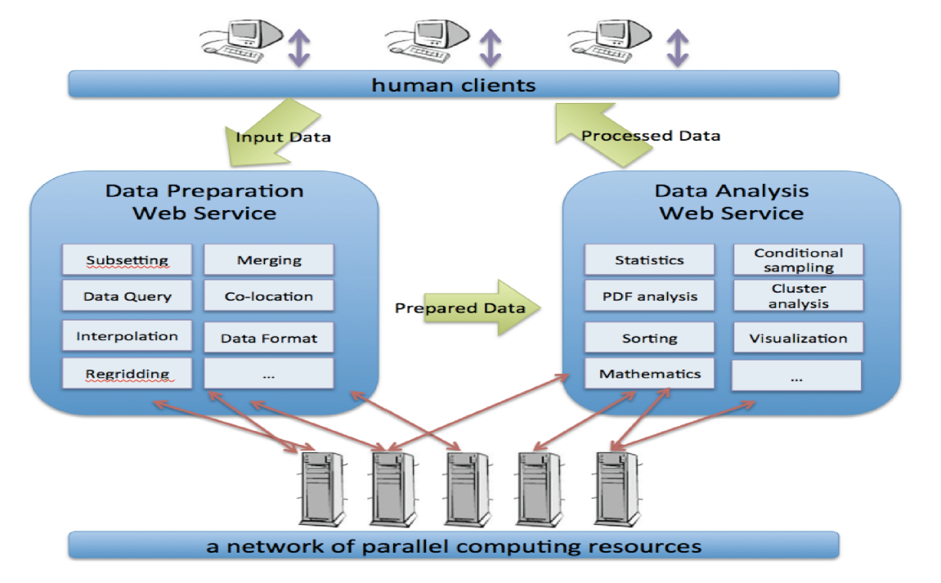
PAWS-CMDA: Parallel Web-Service Climate Model Diagnostic Analyzer PI: Seungwon Lee, JPL
Objective
Develop a parallel, distributed web-service oriented system to enable multi-aspect physics-based and phenomenon-oriented climate model performance evaluation and diagnosis through the comprehensive and synergistic use of multiple observational data, reanalysis data, and model outputs.
Significance
Scientific and technological advances in NASA’s climate and weather predictions through multivariate conditional sampling approaches and parallel and distributed web service technologies.
Functional architecture diagram for PAWS-CMDA
Approach
Develop Python-driven data preparation and analysis system. Wrap the existing data analysis tools in Python for integration into the system.
Apply Parallel Python to achieve large-scale distributed parallelism. Use Parallel Python to establish a server network, distribute subtasks to and retrieve results from the server network.
Build web services of the data preparation and analysis system with a dual access mode: web browsers and programs.
Task Schedules and Key Milestones
Tasks completed:
Developed a python-driven data processing/analysis web-service system.
Demonstrated scientific use of the web-service system.
Integrated the web-service system into the Amazon Cloud system.
Tasks planned:
Demonstrate the educational use of the web-service system.
Integrate the web-service system for multi-step analyses.
Apply Parallel Python where appropriate (e.g. Co-location).
Milestones Met:
Implemented the data processing system.
Implemented the data analysis system.
Milestones Planned:
Implement integrated data processing/analysis system.
Co-Is/Collaborators
Lei Pan, Chengxing Zhai, Jonathan Jiang, Benyang Tang, Joao Teixeira

Slide 3
Outline
Technical Status
Programmatic Status
Educational and Outreach Status

Slide 4
Technical Status Summary
Purchased a project dedicated machine consisting of four computing servers and one 100-TB RAID storage.
Developed 10 data analysis tools: 2D/3D averaging and plotting tools, 2 variable correlation, 2 data source difference, 2 variable conditional sampling, 2 dataset collocation in space and time.
Developed a Python-driven system with the data analysis tools in order to provide uniform interface between the computational code and web services.
Built web services with the Python-driven web service technologies using Flask, Gunicorn and Tornado.
Designed and implemented web browser interface for the web services using JavaScript.
Virtualized web servers for flexible service development and deployment.
Developed two new web-services since the last report: conditional sampling, co-location.
Ten web services are available for climate model/satellite data analyses.
Integrated the web-service system into commercial cloud environment: Amazon.
Improved existing web services to provide users with more customization capabilities : display options and data downloading.

Slide 5
Approach Flow Chart
Develop Analysis Tool
Integrate web-service system into Cloud
Wrap Analysis Tool with Python Caller
Virtualize web-service system
Build Web Service
Build Web Browser Interface

Slide 6
Functional Architecture Diagram
or
Cloud Computing Resources

Slide 7
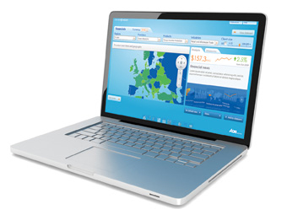


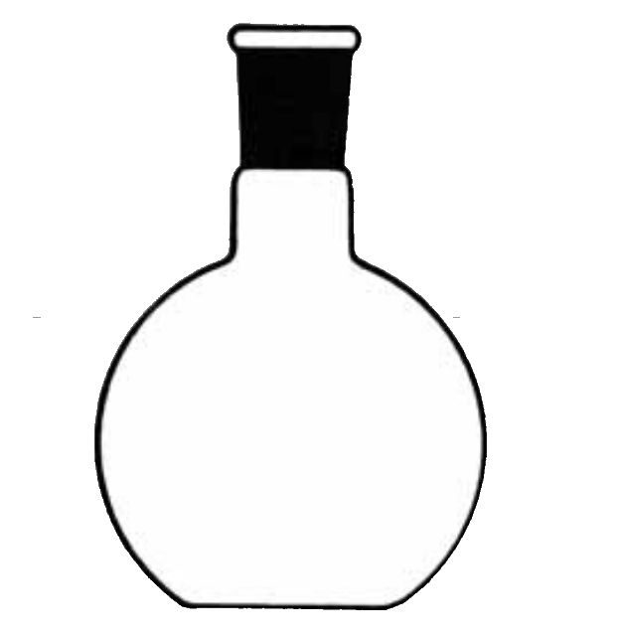



Service Diagram with Technical Components
Client
(Web Browser, JavaScript)
URI
(scoping + method)
URI
(results)
JSON
Octave App.

Slide 8
Analysis Tools
2D Variable Average Map
2D Variable Zonal Mean
2D Variable Time Series
3D Variable 2D Slice Average Map
3D Variable Zonal Mean
3D Variable Vertical Profile Average
Scatter Plot and Correlation of Two Variables
Difference Plot of Two Variables
Conditional Sampling with Two Variables
Collocation of Two Datasets in Space and Time

Slide 9
Data Sets
Model outputs from CMIP5 project
Experiments:
Historical runs and AMIP runs
Physical variables:
Surface temperature, Air temperature, Total cloud fraction, Precipitation, Specific humidity, Cloud liquid water content, Cloud ice water content. Sea surface wind, Sea surface height, Radiation fluxes.
Models:
CCCMA/canesm2, GFDL/esm2g, GISS/e2-h, GISS/e2-r, NCAR/cam5, NCC/noresm, UKMO/hadgem2-es, CCCMA/canam4, CSIRO/mk3.6, GFDL/cm3, IPSL/cm5a-lr, MIROC/miroc5, UKMO/hadgem2-a.
Observation data from Obs4MIPs
AMSR-E surface temperature
AIRS and MLS air temperature
AIRS and MLS water vapor content
MODIS total cloud fraction, leaf area index
GPCP and TRMM precipitation
AVISO sea surface height
CERES radiation fluxes
Observation data elsewhere
Grace equivalent water height
NOAA ocean heat content anomaly
ARGO ocean temperature and salinity profile

Slide 10
Conditional Sampling
Conditional sampling displays the physical quantity X according to the values of another physical quantity E, which is related to X via physical processes.
For example, we may want to display the cloud ice content according to the sea surface temperature. This enables to study the connection between X and E.
E is a sampling variable and is usually a large scale environment variable such as sea surface temperature and wind field at 500 hPa.
X is a sampled variable and is usually a physical quantity related to E by physical processes.
A set of ordered values of E is used to define the boundaries of bins for E. E is sorted according to the bins. X is assigned to a sampling E bin according to its associated E value.

Slide 11
Mathematical Formulation of Conditional Sampling

Slide 12
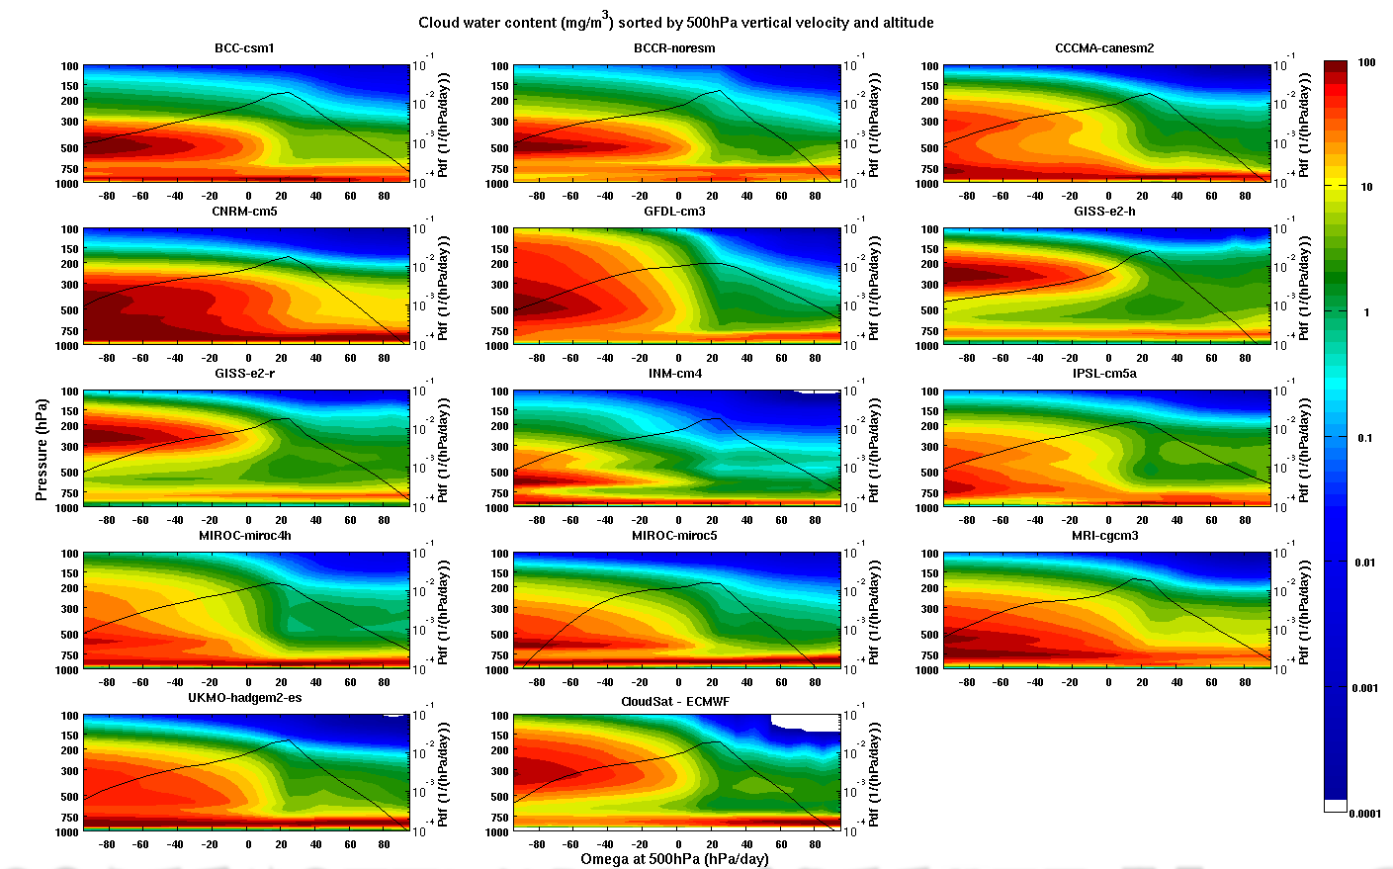
Scientific Use of Conditional Sampling
Cloud water content (cwc) vs vertical velocity (wap) at 500hPa

Slide 13
Co-location of Datasets
A-train constellation multi-sensor data offer global observational constraints for the Earth’s weather and climate models.
However, each instrument has a different resolution, sensitivity, and characteristics, which make the direction comparison, cross validation, and comprehensive use of the data difficult.
We developed a tool to temporally and spatially co-locate a source data product with a given target data product.
Target Data
Colocation Tool
Target Data
Source Data
Colocated Data

Slide 14
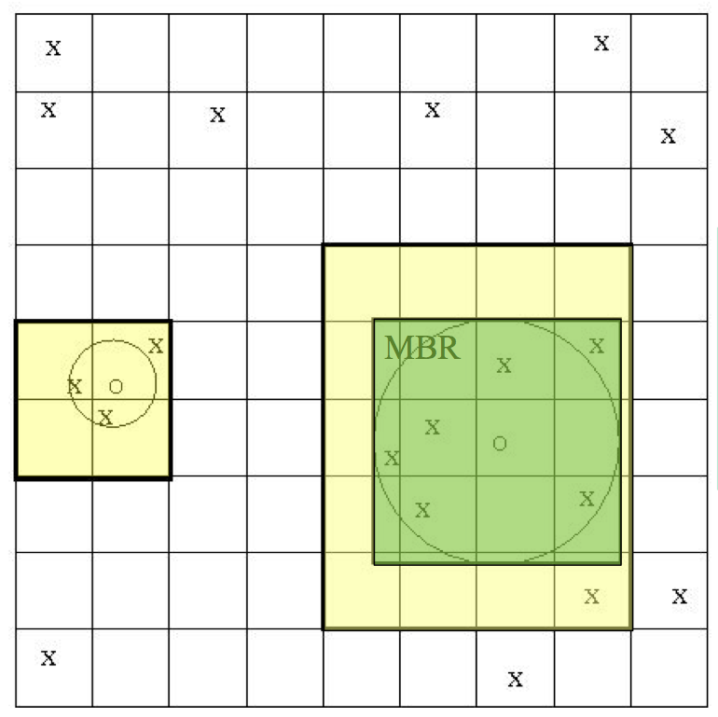
Co-location Algorithm
Nearest neighbor finding algorithm with the complexity of O(m+n), where n is the number of target points and m the number of source points.
Overlay k by k grid on target points where k=sqrt(n) [O(k)].
Register each target point to a cell [O(n)].
For each source point S [O(m)],
find minimum bounding rectangle (MBR) of its footprint.
find grid cells that cover MBR.
For each grid cell G [O(G)], store S to T’s neighbor list sorted by distance between T and S.
For each target point T [O(n)], compute average weighted by the distance among the L nearest neighbor points of T.
X: Target point
O: Source point
C: a constant bounded by max density of target points in MBR, which is not proportional to n.
When L=1, nearest neighbor; when L>1, average of L nearest neighbors
Footprint

Slide 15
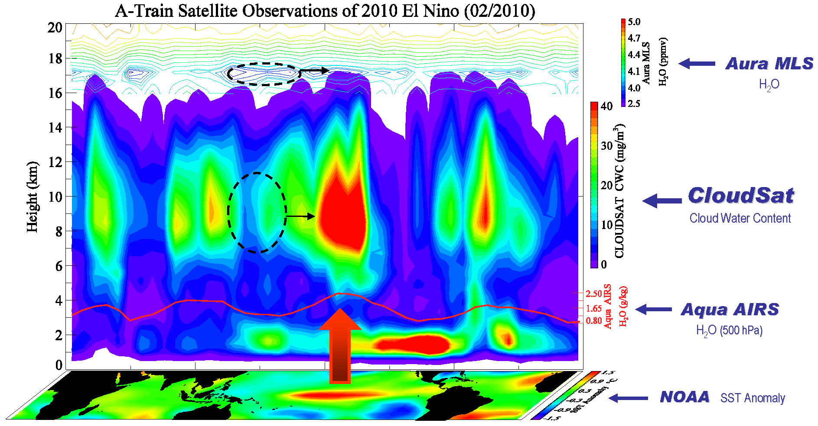
Scientific Use of Co-location
Collocated measurements from Aura MLS, CloudSat, Aqua AIRS and used to study the effect of El Nino event.

Slide 16
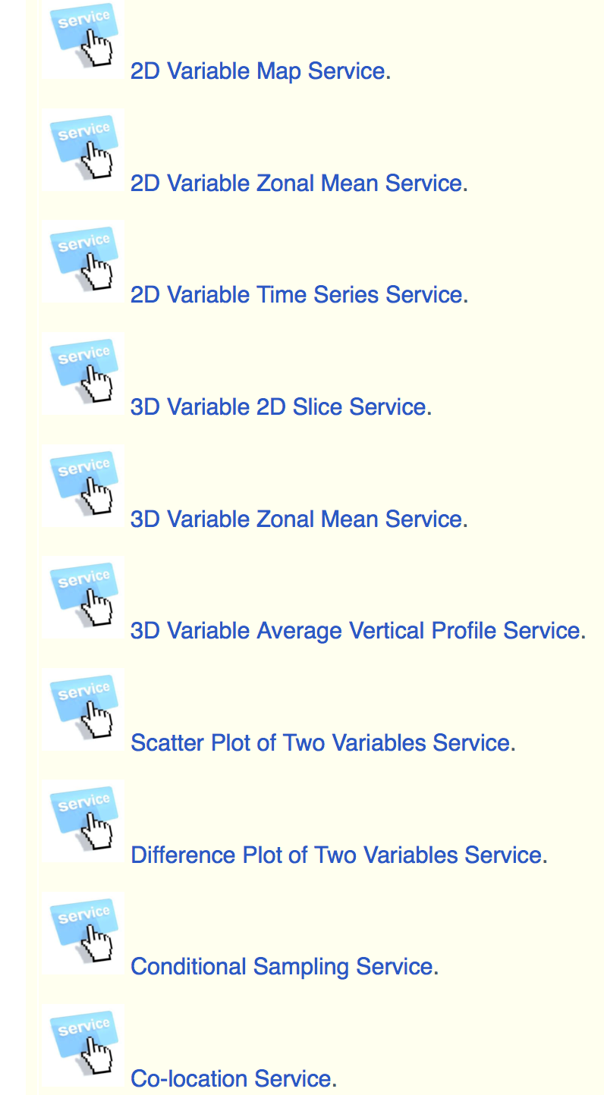
Web Services
From our web server gate-way site:
http://cmacws4.jpl.nasa.gov:8080/cmac/

Slide 17
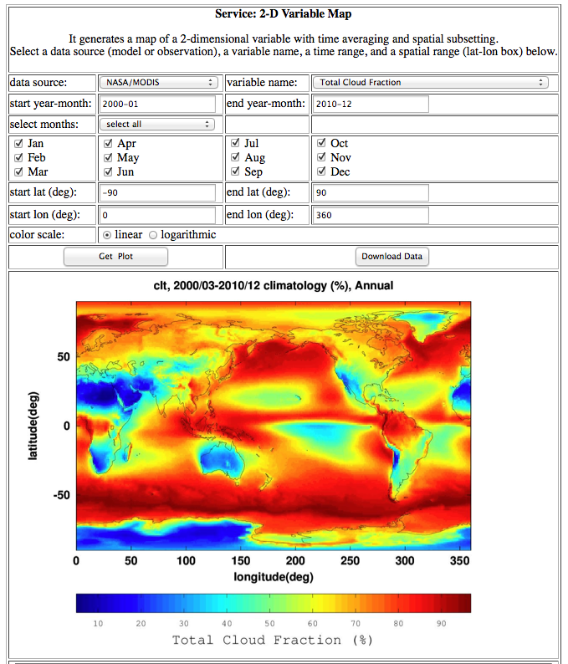

Slide 18
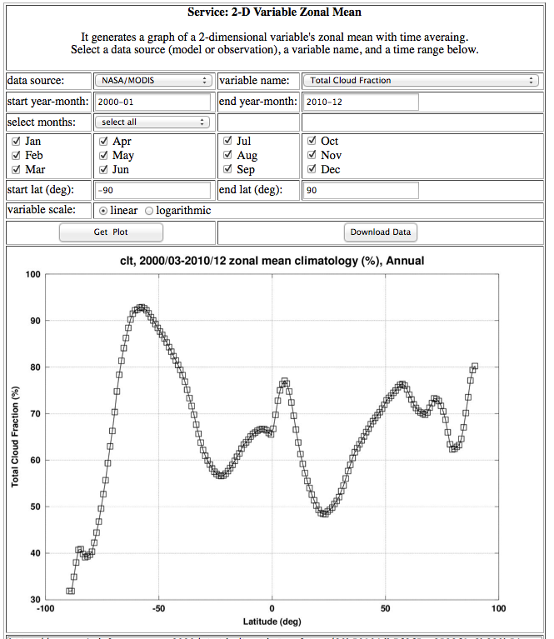

Slide 19
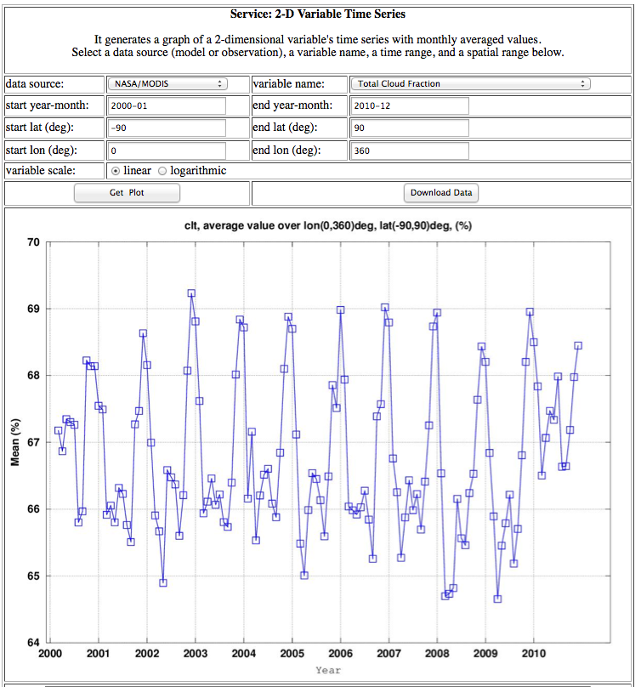

Slide 20
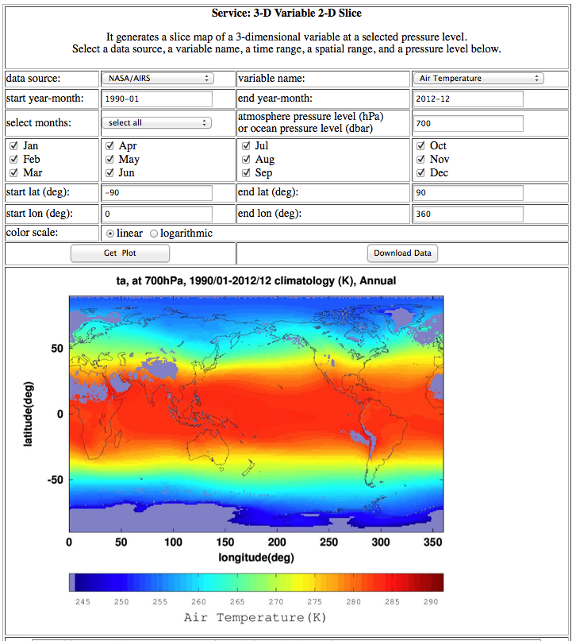

Slide 21
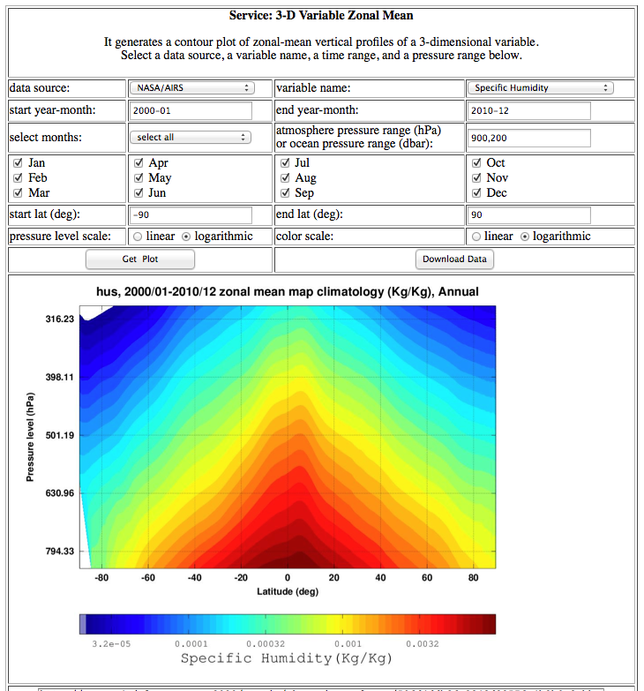

Slide 22
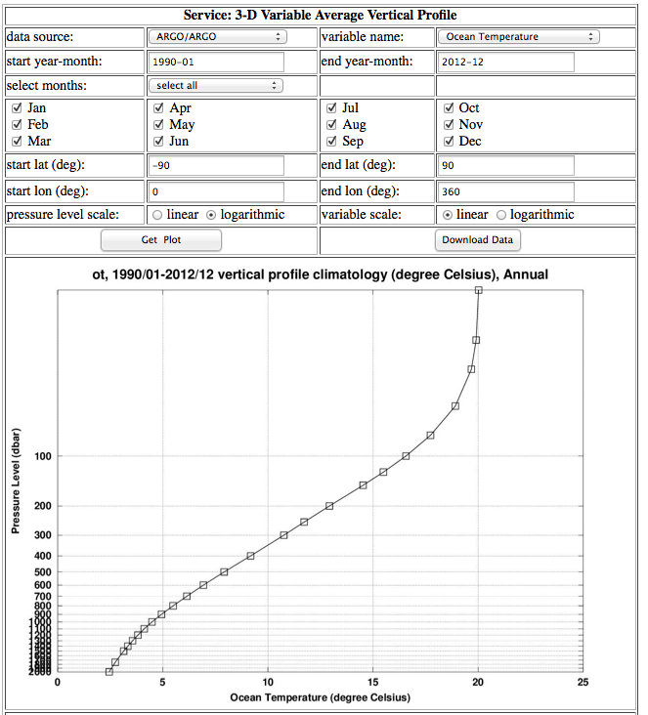

Slide 23
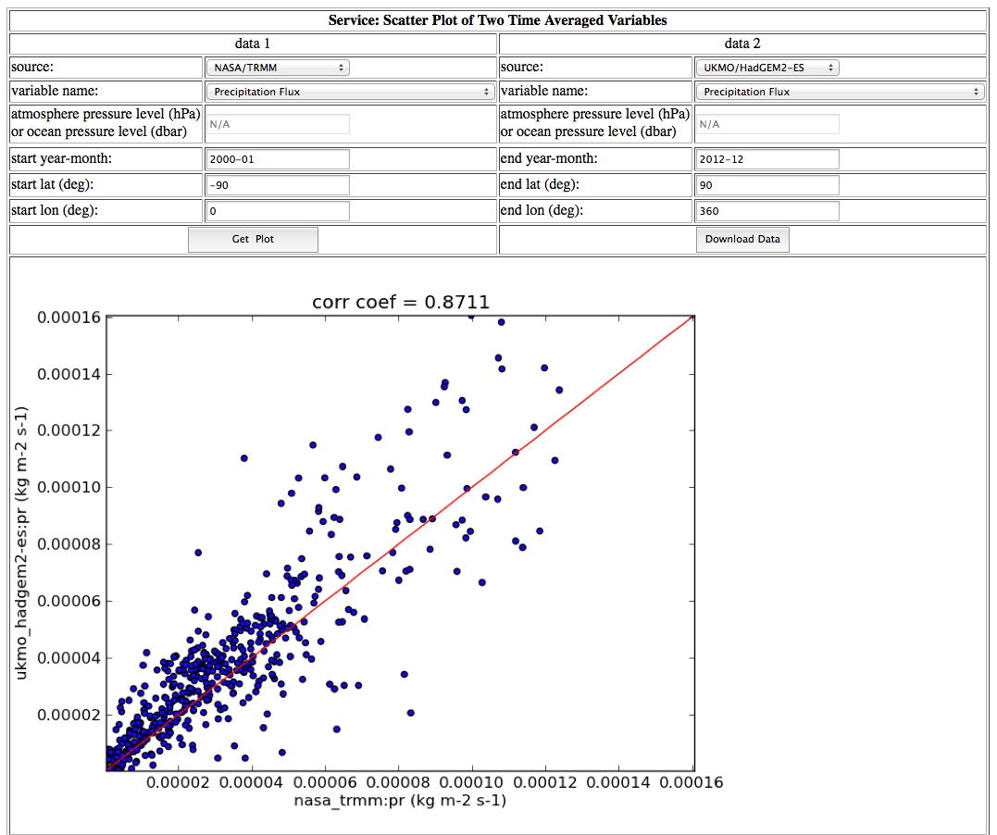

Slide 24
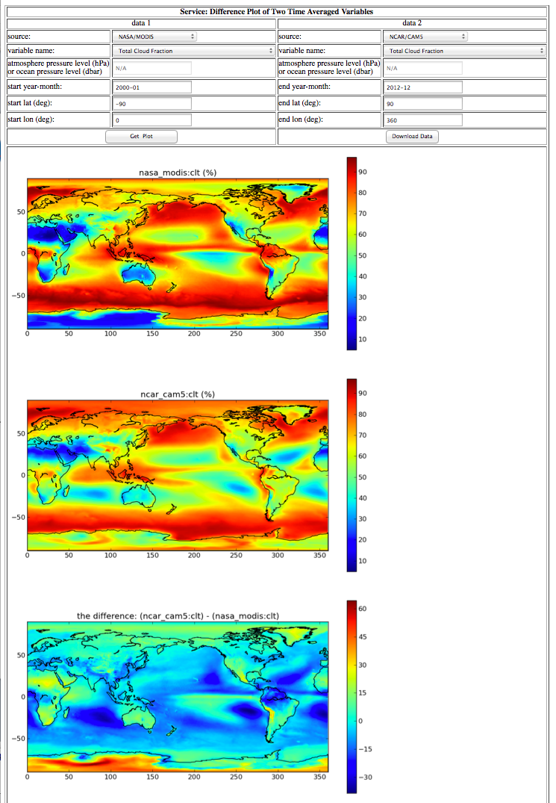

Slide 25
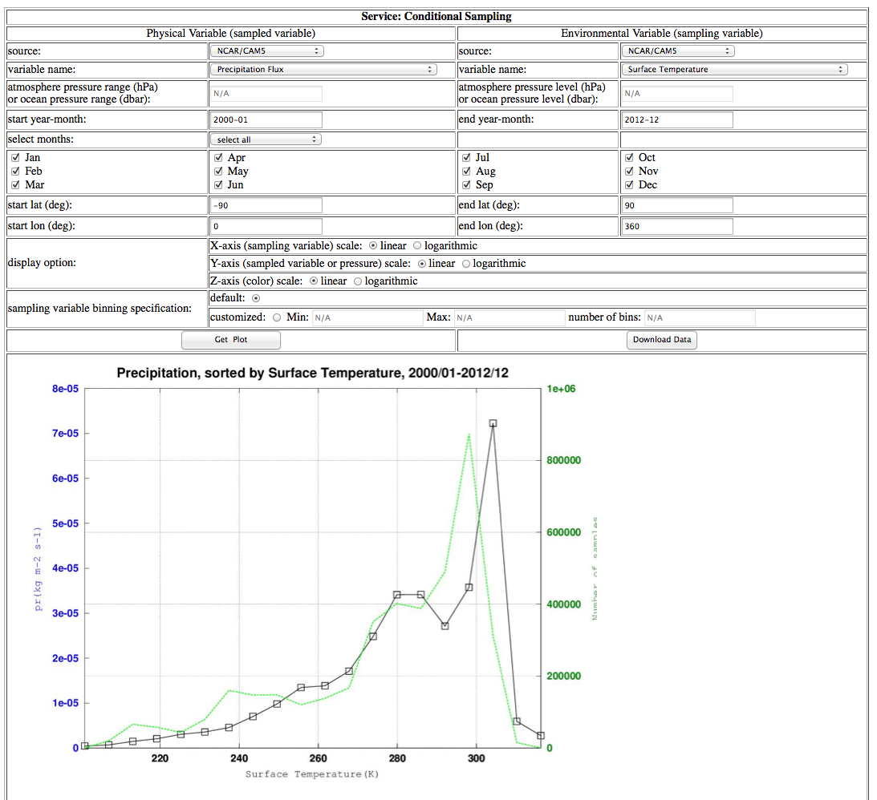

Slide 26
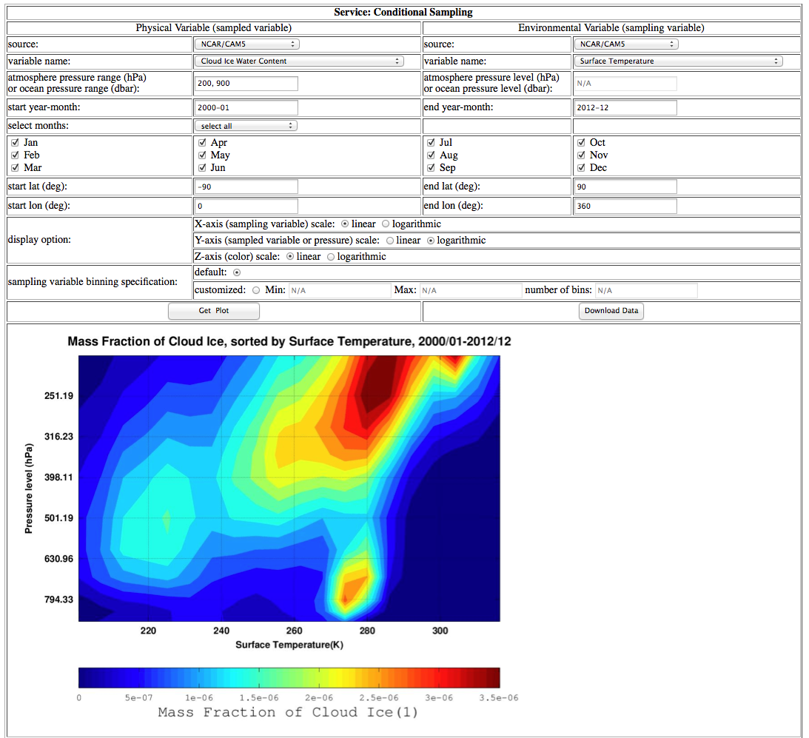

Slide 27
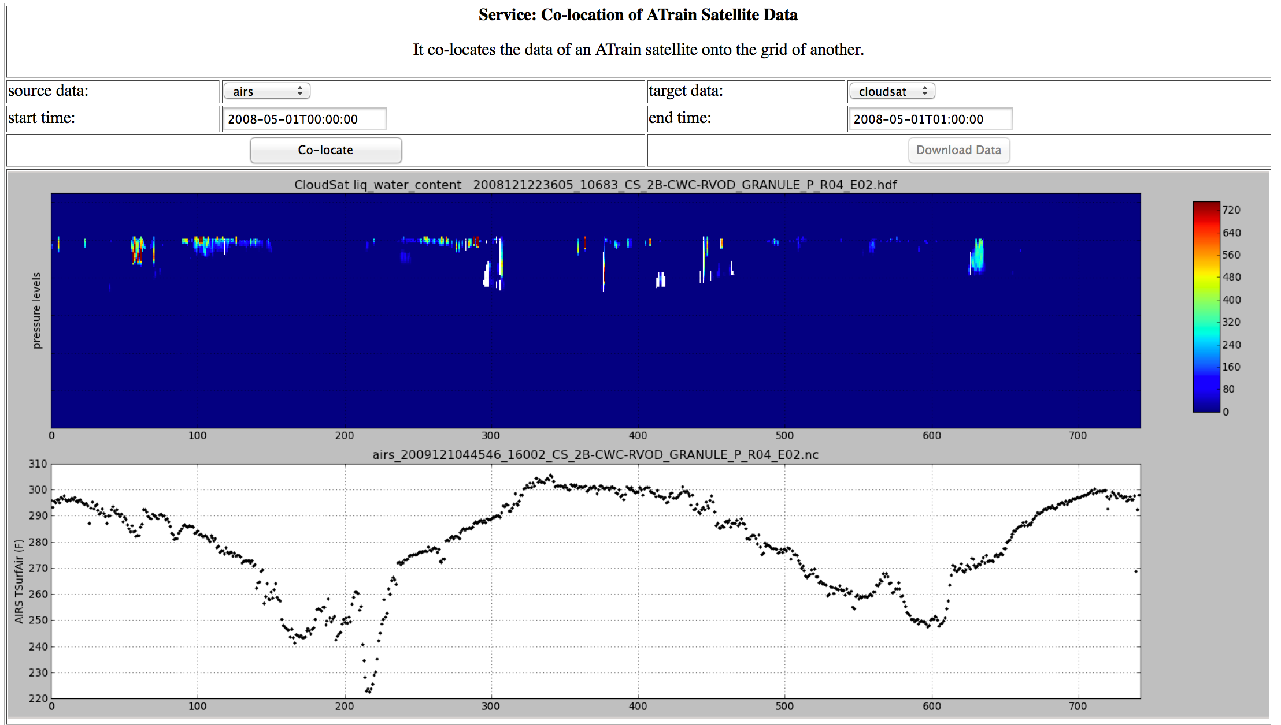

Slide 28
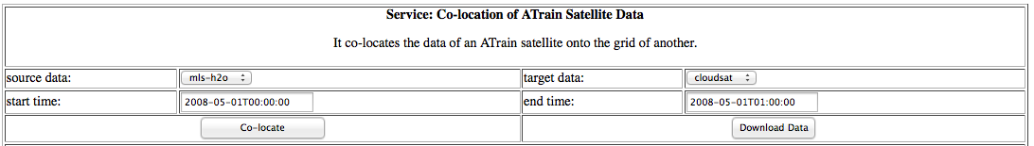
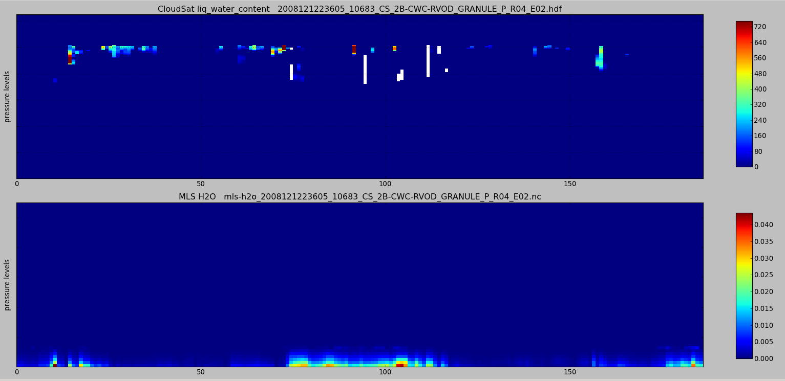

Slide 29
Cloud Computing
Integrated the web service system into Amazon cloud environment using EarthKit.
Adapted existing EarthKit workshop platform.
Simplied UI by removing in-browser tutorial and SSH console.
Streamlined platform for dynamically launching virtual machines (VMs) for students.
Integrated CMAC web service system into Earthkit workshop platform.
Deployed CMAC web service into Amazon EC2 image.
Created CMAC data snapshot for use during the workshop.
Overview of Architecture
CMAC Web
Service
Amazon
Machine Image
Student VM
EarthKit
Workshop
Student VM
CMAC Data
Amazon EBS
Snapshot
Student VM

Slide 30
Cloud Computing Demo
http://climate.earthkit.jpl.net
Login
Welcome screen with cloud launcher
Launching: provisioning stage
Launching: booting stage
Cloud computing ready to start
Landing page for climate summer school tool
Select analysis web service
Select parameters for the analysis
View analysis result
Cloud computing shutting down

Slide 31
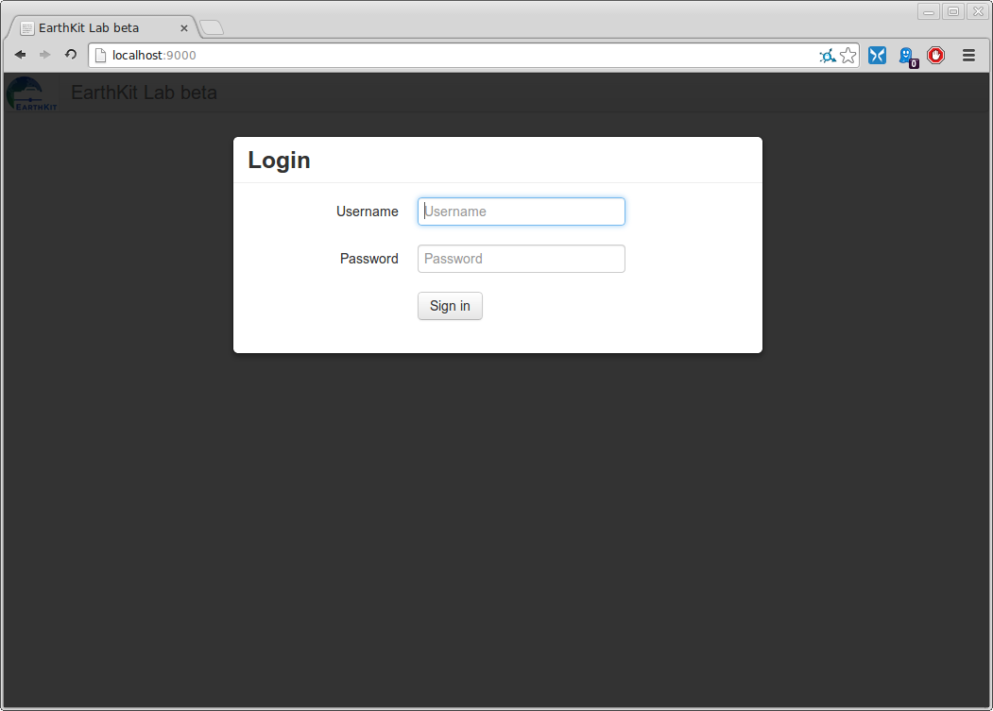
Login

Slide 32
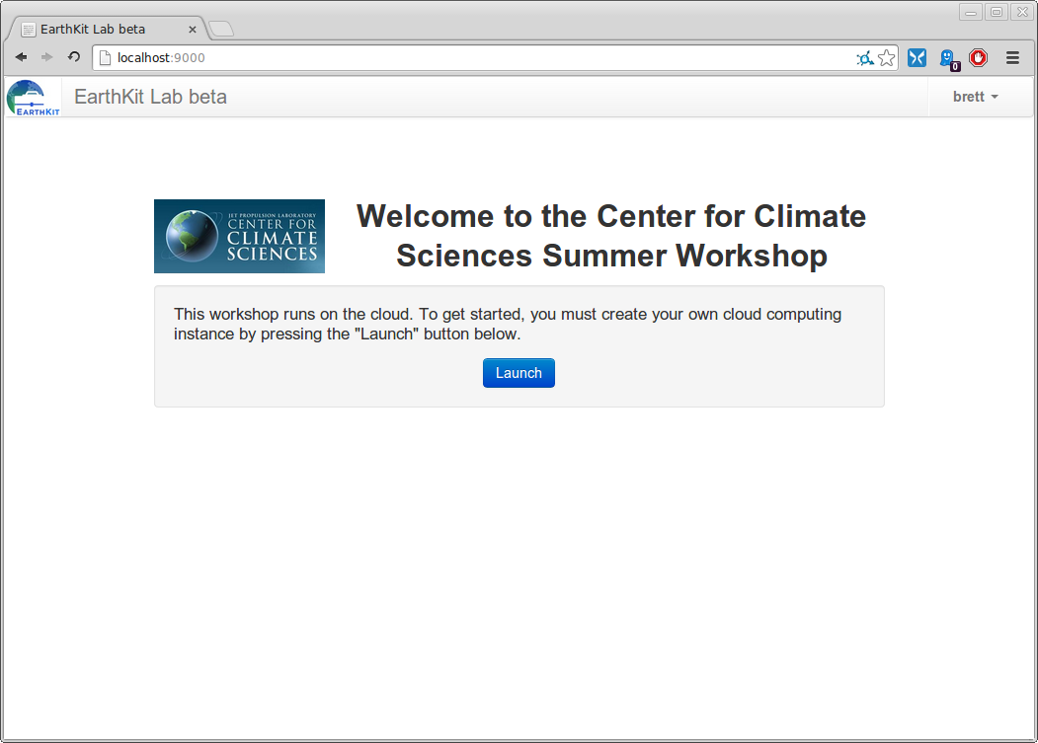
Welcome screen with cloud launcher

Slide 33
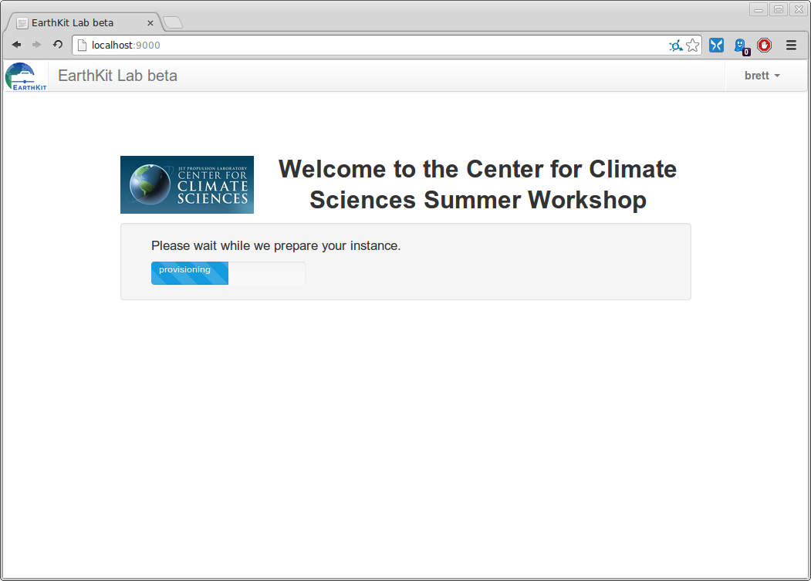
Launching: provisioning stage

Slide 34
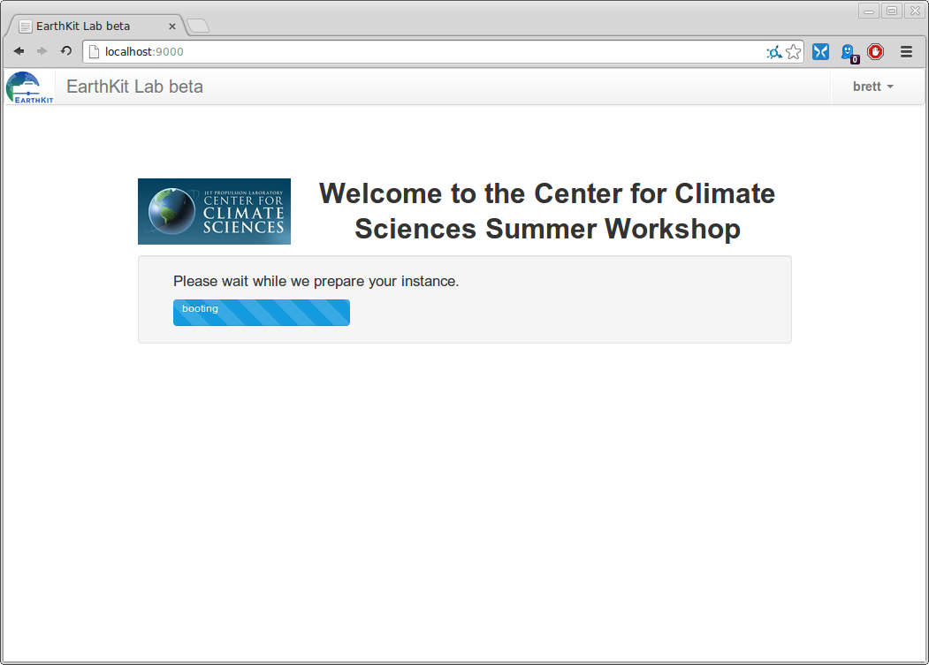
Launching: booting stage

Slide 35
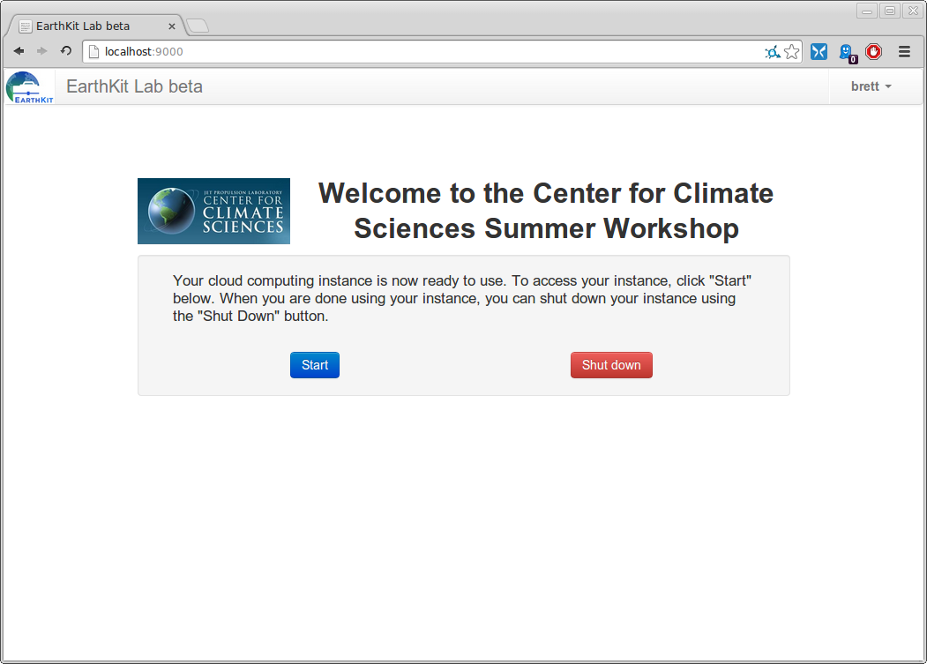
Cloud computer ready to start

Slide 36
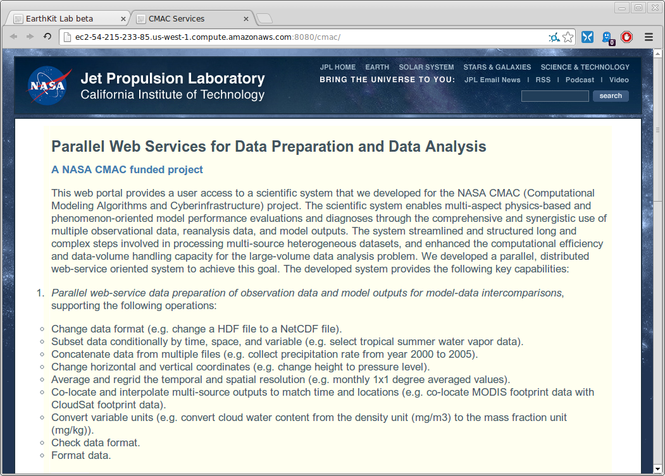
Landing page for climate workshop

Slide 37
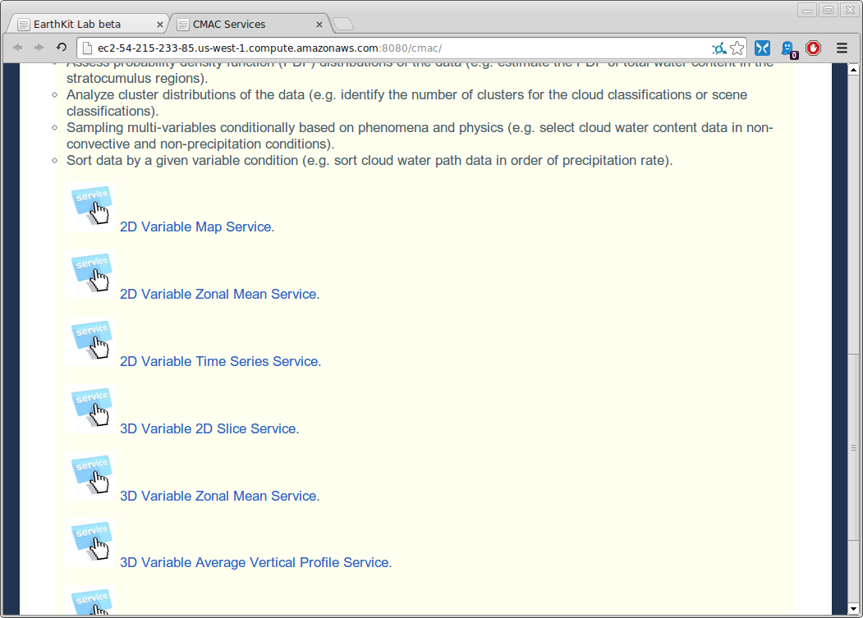
Analysis menu

Slide 38
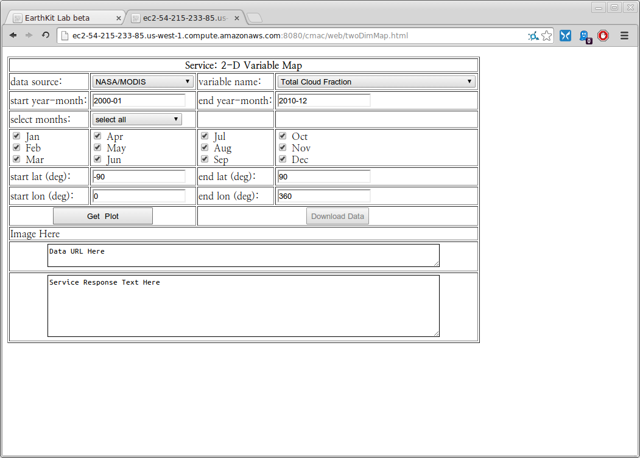
Parameter page

Slide 39
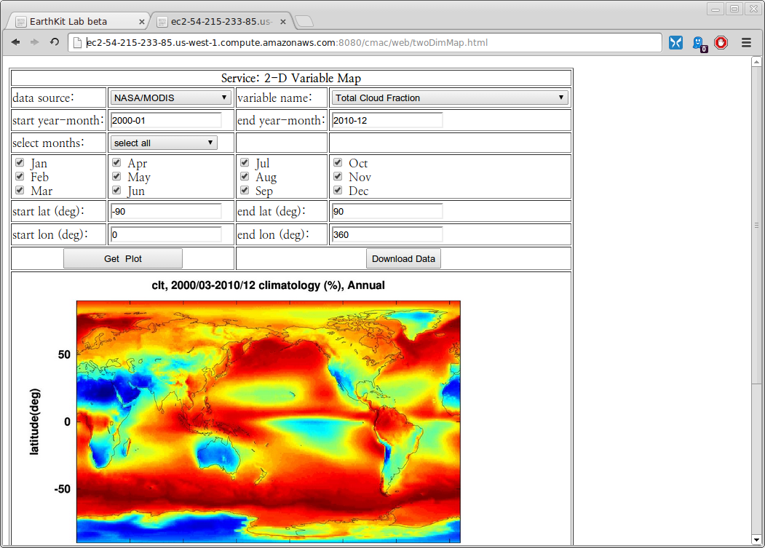
Analysis visualization

Slide 40
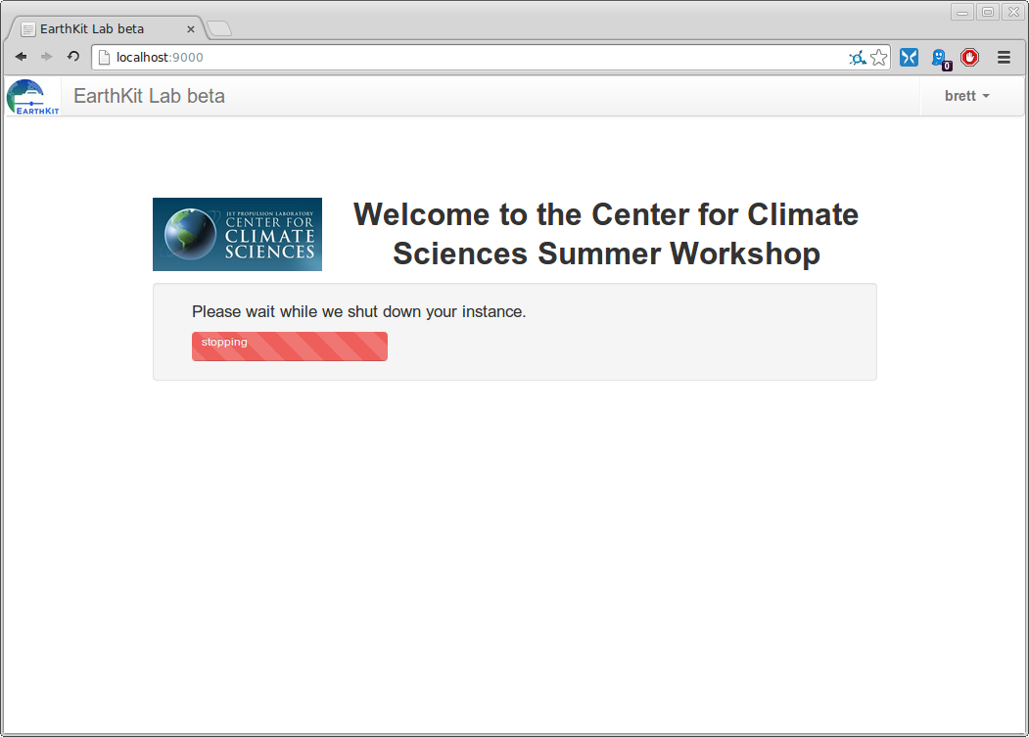
Cloud computer shutting down

Slide 41
Planned Technical Work
Improve the functionality and dataset support of co-location web service.
Develop a regridding web service.
Apply Parallel Python where appropriate.
Integrate the web-service system for multi-step analyses (e.g. regridding and conditional sampling, co-location and averaging).
Deploy the latest version of the web-service system and dataset into Amazon EC2 image.

Slide 42
Outline
Technical Status
Programmatic Status
Educational and Outreach Status

Slide 43
Programmatic Status Summary
This CMAC project started on October 1st, 2012.
This project has 9 tasks, 4 deliverables, and 3 milestones.
The schedule/order of the tasks is adjusted to improve the development cycle and support the new educational opportunity.
6 tasks are completed, 3 deliverables are completed, and 2 milestones are met.
This project total budget is $616K with $303K for year 1 and $313K for year 2.
$165K (53% of year 2 budget) is spent as of April 3, 2014.
The actual cost is on track with the planned budget.

Slide 44
Task Status
Completed:
Developed a python-drive data processing system.
Developed a web service for python driven data processing system.
Developed a python-drive data analysis system.
Developed a web service for python driven data analysis system.
Demonstrated the scientific use of the data processing system.
Demonstrated the scientific use of the data analysis system.
Integrated the web-service system into the Amazon Cloud system.
Planned:
Demonstrate the educational use of the web-service system.
Integrate the web-service system for multi-step analyses.
Apply Parallel Python where appropriate (e.g. Co-location).

Slide 45
Deliverable/Milestone Status
Completed:
Delivered an Interim Project Report in Year 1 (D1).
Delivered an Annual Project Report in Year 1 (D2).
Delivered an Interim Project Report in Year 2 (D3).
Implemented the data processing system (MS 1).
Implemented the data analysis system (MS 2).
Planned:
Deliver a Final Project Report (D4).
Implement integrated data processing/analysis system (MS 3).

Slide 46
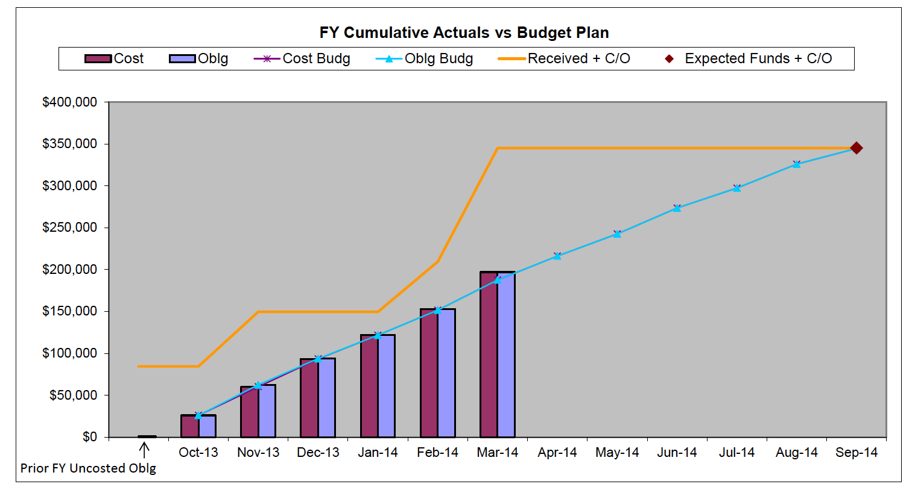
Project Cost Status
Total project budget for Year 2 is $313K.
As of the end of March 2014, the project spent $165K (53%) and is on track with the planned budget.

Slide 47
Outline
Technical Status
Programmatic Status
Educational and Outreach Status

Slide 48
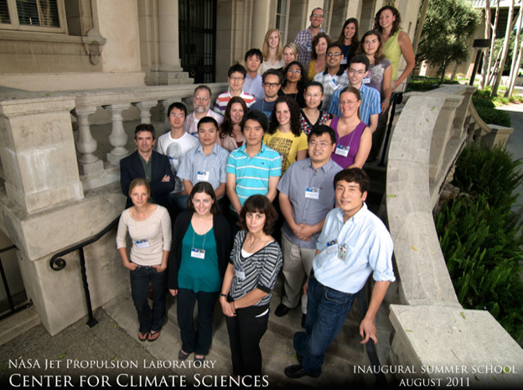
Educational and Outreach Status
The Center for Climate Sciences (CCS) plans to host a summer school in 2014.
CCS is working on obtaining the JPL and NASA approval for the summer school in 2014.
The summer school will bring together the next generation of climate scientists – about 30 graduate students and postdocs from around the world – to engage with premier climate scientists from JPL and elsewhere. http://climatesciences.jpl.nasa.gov/events/summer-school
This CMAC project demonstrated the capability of the tool to CCS in April, 2013.
CCS will use the PAWS-CMDA tool for its summer school in 2014.
We designed requirements for the education tool: the user interface should be web-browser based; the web server or web system should support >30 simultaneous web-service requests.
Several web-services to support model-data intercomparisons are developed: analysis and visualization of 2D/3D variable multi-annual means using Coupled Model Intercomparison Project Phase 5 (CMIP5) model outputs and Obs4MIPs datasets.
Multi-variable analysis web-services are developed: correlation, difference, conditional sampling.
Collocation of observational Level 2 datasets is developed as a web service.
New datasets are introduced and integrated into the web service system.
The web service system is imported and integrated into the Amazon cloud environment.

Slide 49
CCS Summer School Tool & Curriculum
The CCS summer school education tool will be a web-browser based tool.
The tool will support the following functionalities:
2D/3D variable map of annual means with spatial and temporal selection
2D/3D variable zonal means with temporal selection
2D variable time series with spatial and temporal selection
3D variable vertical profile with spatial and temporal selection
Two 2D/3D variable scatter plot and correlation analyses with spatial, temporal and vertical level selection.
Two 2D/3D variable difference plot with spatial, temporal and vertical level selection.
Physical variable conditionally sampled by another physical variable
Co-location of A-Train satellite data sets.
The tool will be used to support the following curriculum:
Learn the aspects of both model outputs and NASA satellite observations.
Compare the model outputs with the observation datasets.
Consider the effect of the observation uncertainty and limitation on the model comparison.
Report model systematic biases if exist.
Examine the potential causes of the model biases.

Slide 50
Backup Slides

Slide 51
Project Machine Purchase and Installation
We purchased a machine dedicated for this project at the cost of $30K in January 2013.
The project machine consists of
Two servers, each having 12 cores, 64 GB physical memory, and 4 TB disk space.
One RAID storage server with 100 TB usable space, 12 cores, and 64 GB physical memory.
One Gigabit switch to connect the three servers.
Machine installation
CentOS Linux
RAID server made head node (JPL LAN IP)
Three servers made compute nodes (local IP: 192.xxx.xxx.xxx)
RAID cross mounted to all nodes
/home shared by all nodes
VMWare player (free) installed for virtualization

Slide 52
Adapting Existing Analysis Tools
Existing Matlab code is adapted to this project.
The adaptation only requires to develop interface routines that facilitate data passing between user and core functions.
To meet the requirement of large scalability of PAWS-CMDA, we use GNU Octave, which is a license-free version of Matlab.
A minimal adjustment of the existing Matlab code is needed to make it executable in Octave environment.
Data format difference in reading netcdf files
A few capabilities from some matlab toolboxes, e.g. coastal line for map, juliandate
Current capabilities of the adapted Octave code:
2D variable map
2D variable time series
2D zonal mean
3D variable zonal mean
3D vertical profiles
3D pressure-level slice map

Slide 53
Developing New Tools
Chose Python for new tool development since the rest of the system is Python driven.
Computational performance and data access performance are sufficient with Python code.
Developed new Python-driven data analysis tools
Two variable scatter plot and correlation analysis
Two variable difference plot

Slide 54
Developing Python-Driven System
Wrap legacy data analysis tools for integration into the system.
Application code in GNU Octave (a free Matlab)
Use python caller code to spawn off the App. as a child process (using python subprocess)
The python caller prepares all input arguments for the child process
The python caller defines where the child process puts its results (e.g., images) using input argument
The stdout and stderr of child process are captured by the python caller at joining point (the way for the App. to communicate back to the python caller)
The legacy App. now looks like a python application

Slide 55
Building Web Services
Use Flask, an open source microframework for python apps.
Provide entry point code
Parse input arguments from client
Call aforementioned python app., passing input arguments
Get return values and pass them to client in Json format
REST-ful style: scoping info. placed in URI and method info. conveyed in HTTP method
Example: http://cmacws.jpl.nasa.gov:8089/twoDimMap/display?model=ukmo_hadgem2-a&var=ts&start_time=199001&end_time=199512&lon1=0&lon2=100&lat1=-29&lat2=29&months=1,2,3
Define port number and location of static data
Separate app. traffic from static HTTP traffic
Use Gunicorn to provide Web Server Gateway Interface (WSGI) service (app.)
Use Tornado to provide web service (static HTTP)

Slide 56
Building Web Browser Interface
Designed web browser interface for our web services using JavaScript.
Provide an intuitive and easy access to the web services.
Implemented the web browser interface for 8 web services.
2D variable map display
2D variable time series
2D zonal mean plots.
3D variable zonal mean
3D vertical profiles
3D pressure-level slice map
Two variable scatter plot and correlation analysis
Two variable difference plot
Users can display plots and download the output result in NetCDF file.

Slide 57
Virtualizing Service
Use VMWare (VMPlayer)
Host OS: CentOS (Linux)
Guest OS: Ubuntu (Linux)
Open source software, python packages, etc. installed on guest OS
Services deployed to guest OS
Developers’ user accounts are on guest OS
RAID disk, with 100TB capacity, is mapped from host OS to guest OS
Host ports need to be open and forwarded to guest OS
Benefits: guest OS runs on any host OS, so moving is quick; no need to reinstall all the dependent packages again

Slide 58
Public Access to the web servers
Perimeter access approval for our web servers is necessary for summer school support since the school will be held at the Caltech campus, which is outside JPL network.
JPL approved the content of the web page for export control compliance (June 2013).
JPL approved inbound perimeter access to our web servers (July 2013).
Three web servers have inbound access approved from outside JPL network.
http://cmacws.jpl.nasa.gov:8080/cmac/
http://cmacws2.jpl.nasa.gov:8080/cmac/
http://cmacws4.jpl.nasa.gov:8080/cmac/
One web server is kept inside the JPL network for development.
http://cmacws3.jpl.nasa.gov:8080/cmac/

Slide 59
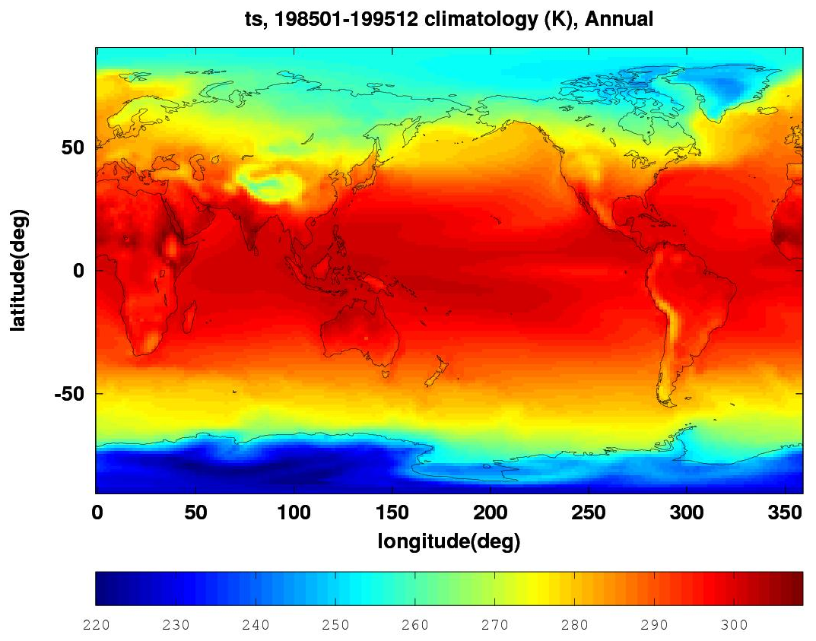
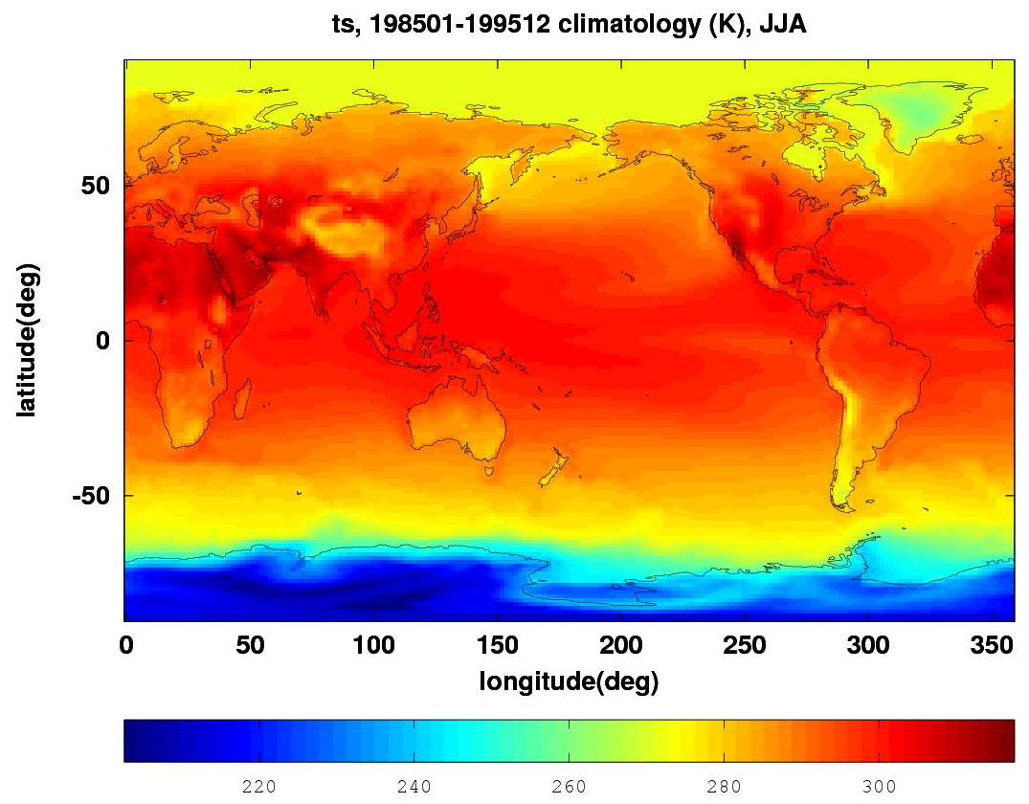
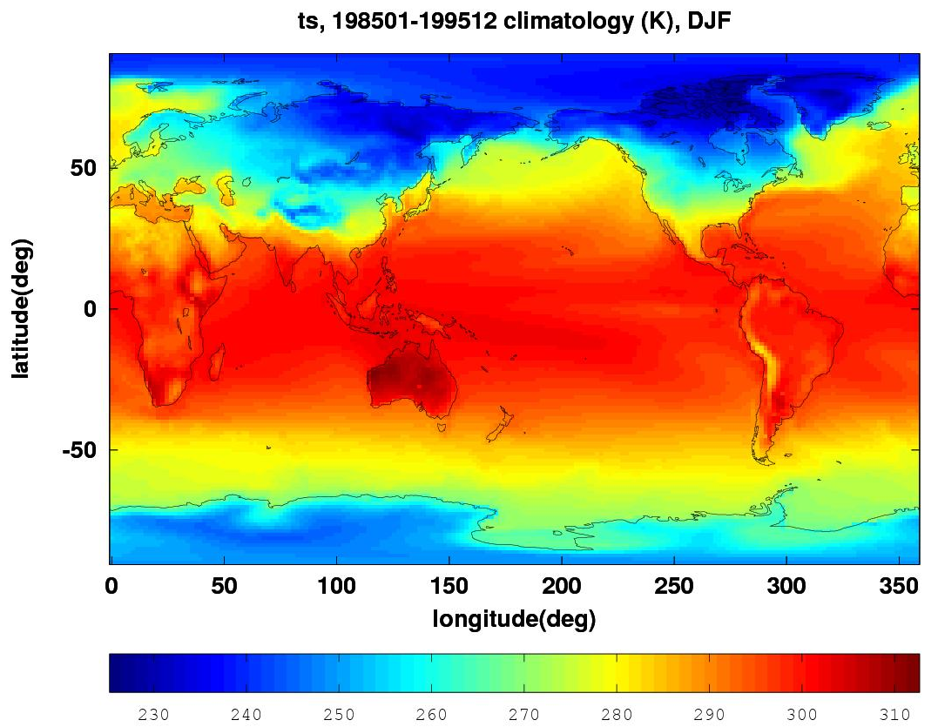
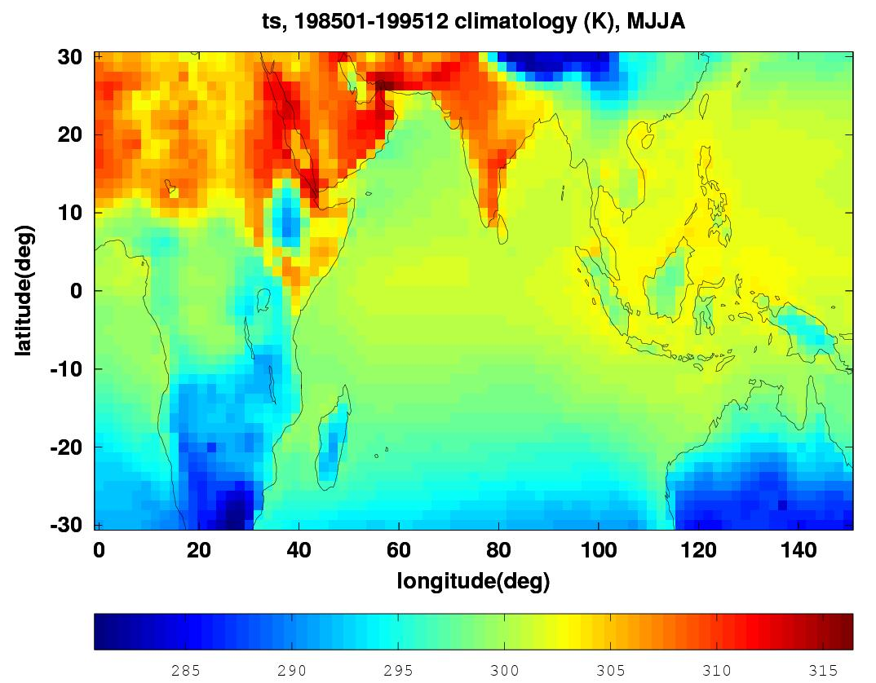
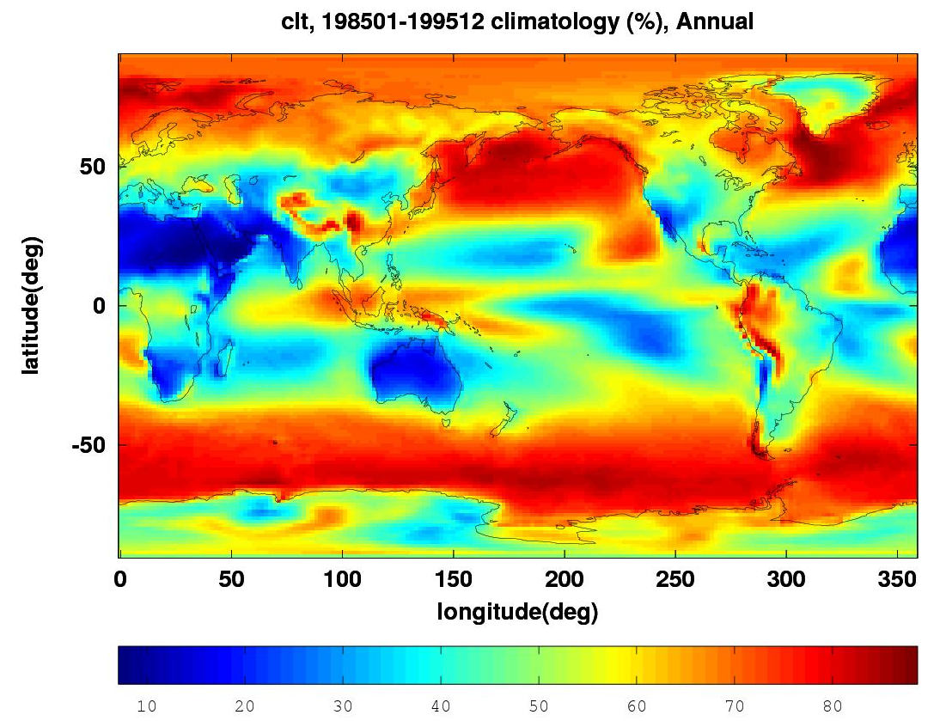
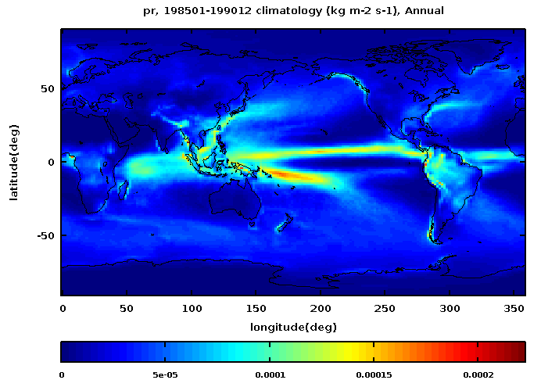
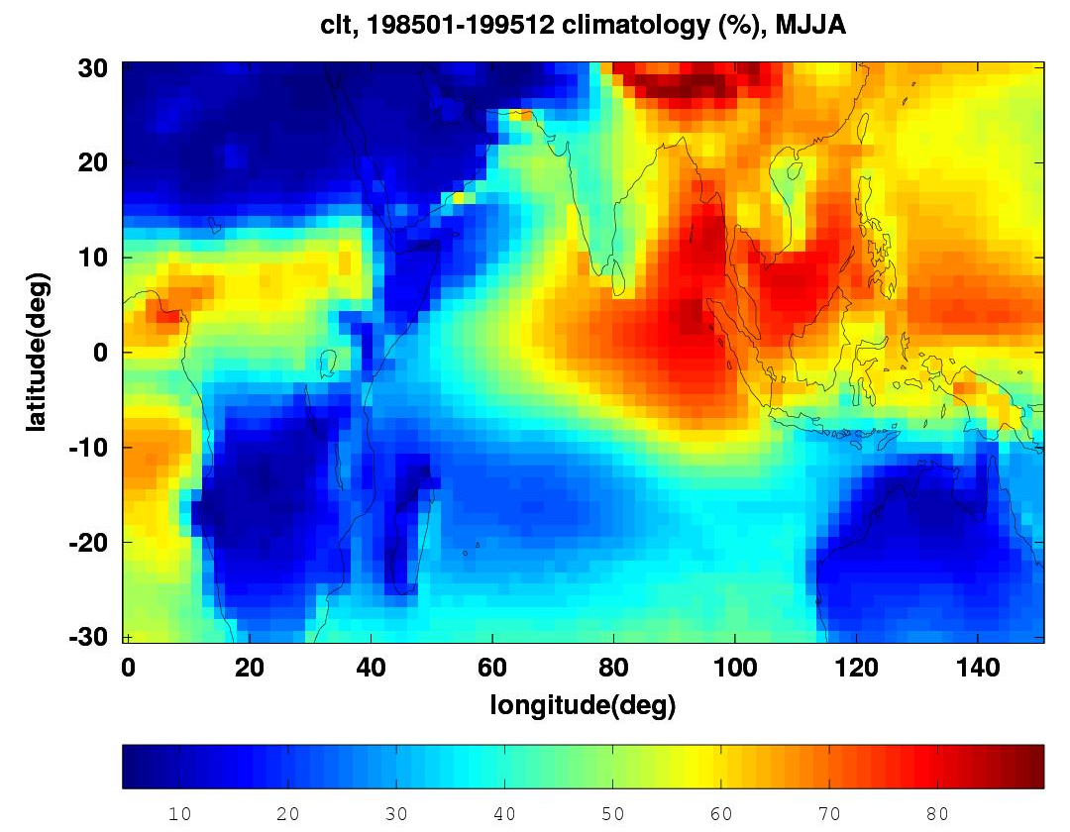
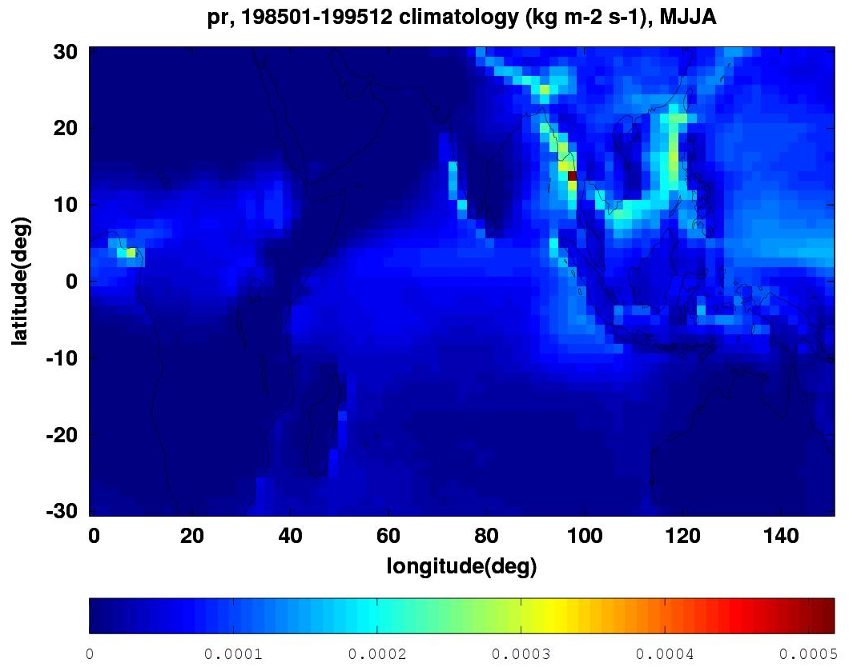
Analysis Capabilities (1)
Display a two dimensional physical variable on a map as function of longitude and latitude
Temporal average is computed for a specified range
User may choose a subset of months in a year to study seasonal variation
Displayed region may be customized for examining details
Surface temperature, annual summer winter
summer, region
cloud fraction
Precipitation
cloud fraction, region
Precipitation, region

Slide 60
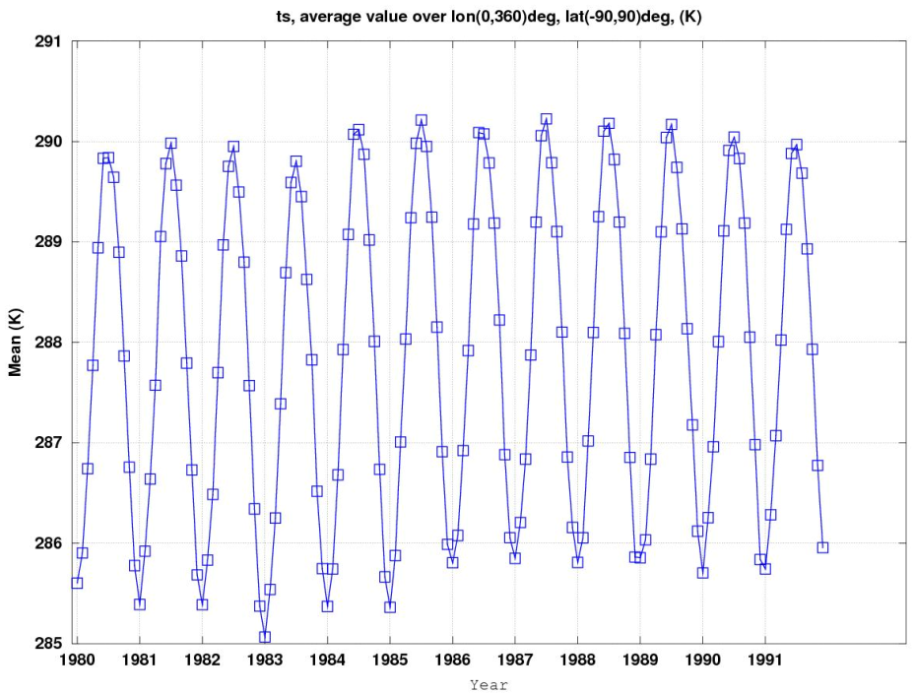
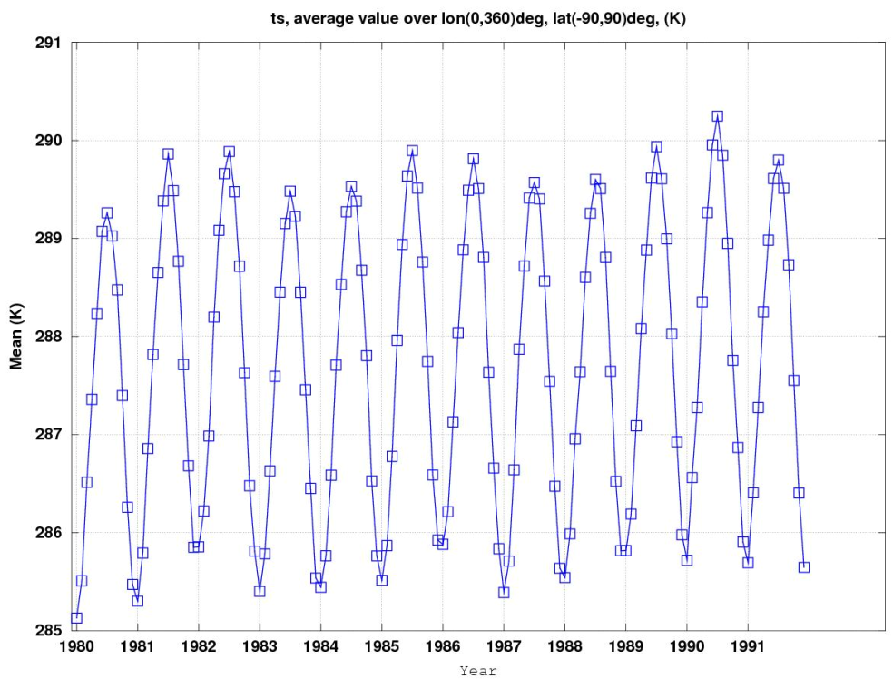
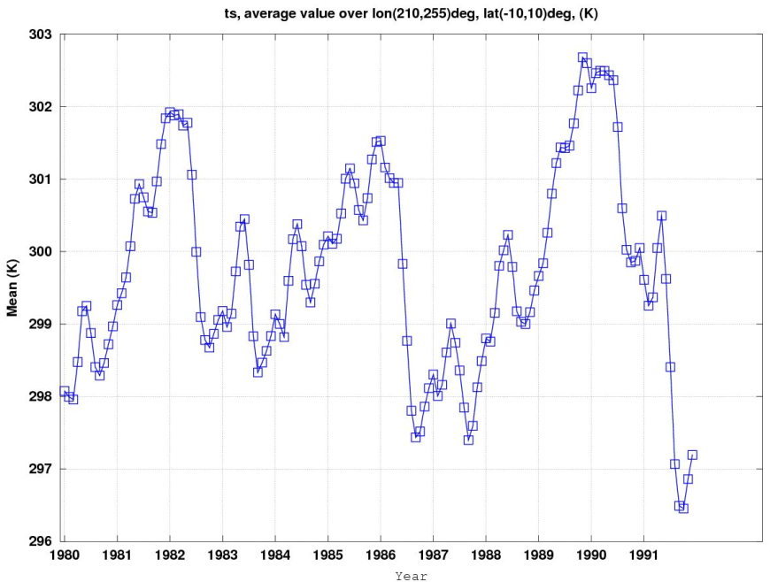
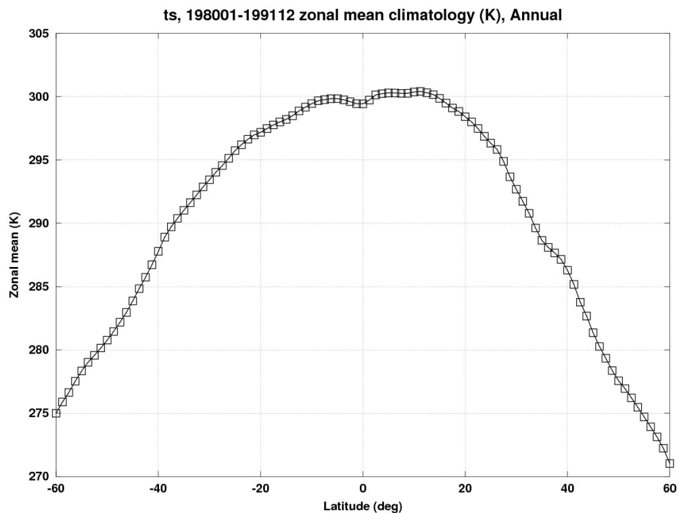
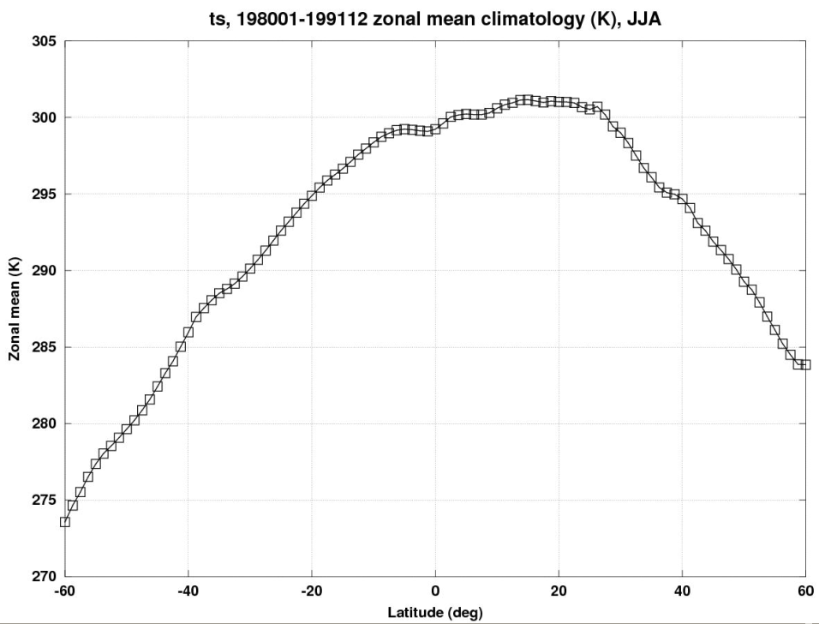
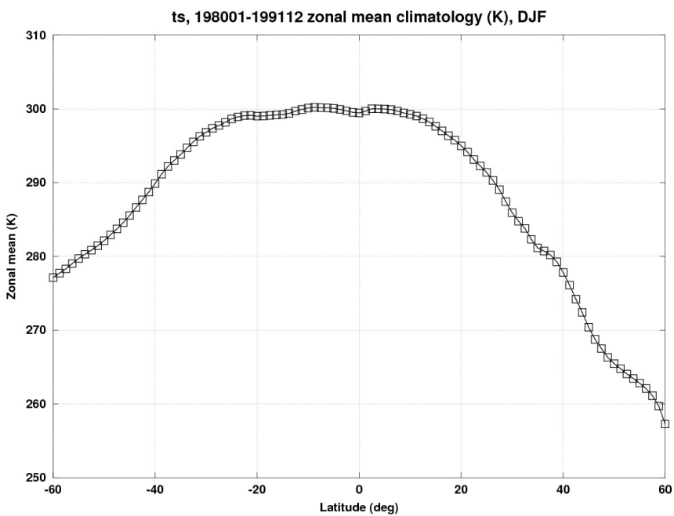
Analysis Capabilities (2)
Plot the time series of a 2D physical variable averaged over a specified region
Plot the zonal mean of a 2D physical variable averaged over a temporal period
User may select months in a year for study seasonal variation
Surface
Temperature
Time series
UKMO_hadgem2-es
NCAR-cam5
NCAR-cam5, Nino 3
Surface
Temperature
zonal means
annual
summer, JJA
winter, DJF

Slide 61
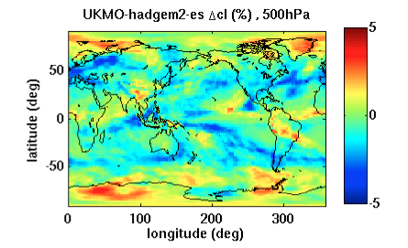
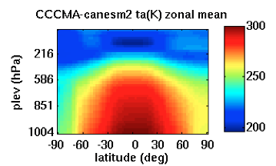
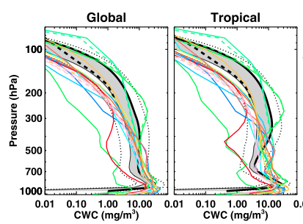
Analysis Capabilities (3)
Plot the pressure-level slice of a 3D physical variable averaged over a specified region and temporal period.
Plot the zonal mean of a 3D physical variable averaged over a temporal period.
Plot the vertical profile of a 3D physical variable averaged over a temporal period.
Cloud fraction change at 500hPa
Zonal mean of air temperature
Vertical profile of cloud water content

Slide 62
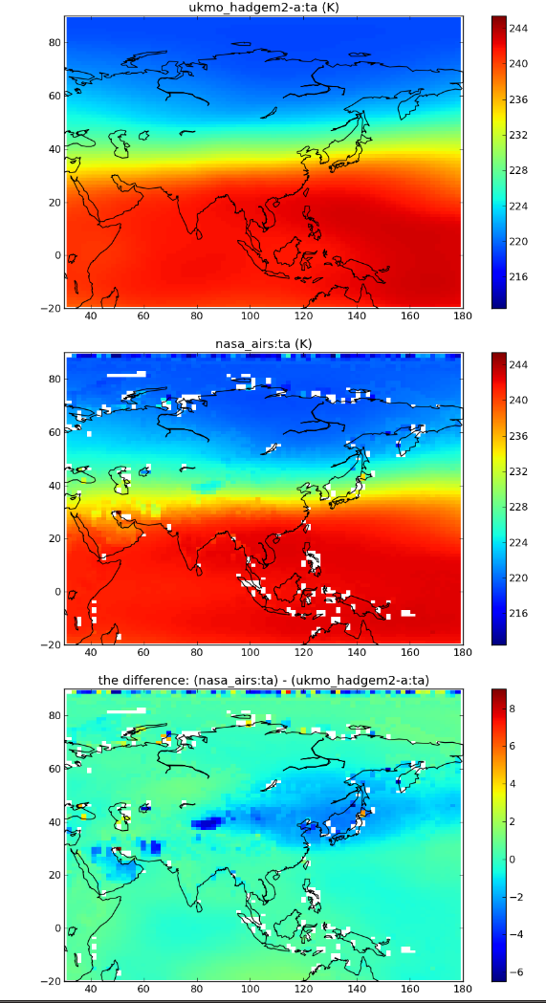

Analysis Capabilities (4)
Plot the difference between two variables over a specified region and averaged over a temporal period.
Plot the scatter of two variables and calculate the correlation between the two.
Air temperature at 300 hPa
Two variable difference
Two variable scatter plot and correlation

Slide 63

Example of planned summer school exercises (1)
The students will be asked to use the monthly mean CMIP5 model outputs and Obs4MIPs datasets to compute and plot the zonal mean total cloud fractions as shown below and report model systematic biases if exist. The students will be also asked to consider the observation uncertainty and limitation and their effect on the comparison with model outputs.

Slide 64

Example of planned summer school exercises (2)
The students will be asked to plot a 3d model parameter (e.g. water vapor H₂O, air temperature) at several different pressure levels (e.g. 100hPa, 215hPa, 600hPa, 900hPa) and compare the model results with Obs4MIPs observational data and report model biases if exist.
The students will be also asked to analyze the potential causes of the systematic model biases.

Slide 65

Example of planned summer school exercises (3)
Study correlation/interplay between cloud, water vapor, precipitation and SST.

